Slide 1
CSC371-Database Systems I Lecture-13 (Lab) (Fall 2023)

Slide 2
Previous Lecture Review
SQL Sub Query

Slide 3
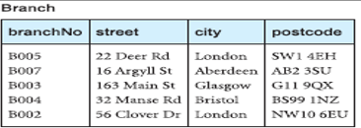
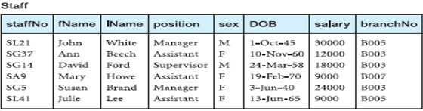
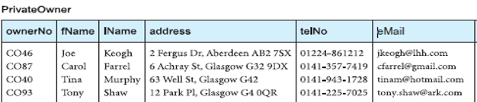
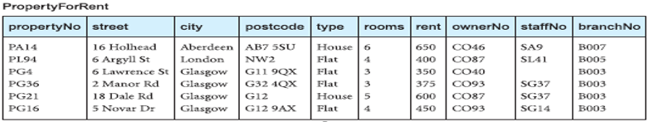

Slide 4
Agenda
SQL Stored Procedure

Slide 5
SQL Stored Procedures
A stored procedure is a prepared SQL code that you can save.
The code can be reused repeatedly.
So if you have an SQL query that you write again and again, save it as a stored procedure, and then just call it to execute it.
You can also pass parameters to a stored procedure, so that the stored procedure can act based on the parameter value(s) that is passed.
A stored procedure can consist of more than one query.

Slide 6
Syntax
CREATE PROCEDURE procedure_name AS sql_statement (s) ;
Execution
EXEC procedure_name;

Slide 7
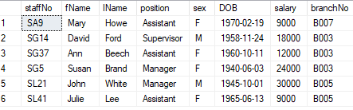
Simple Example
CREATE PROCEDURE SelectAllStaff AS SELECT * FROM Staff;
exec selectallStaff;

Slide 8

Stored Procedure With One Parameter
CREATE PROCEDURE SelectPositionWiseStaff @position varchar(30)
AS
SELECT * FROM staff WHERE position = @position;
exec selectpositionwisestaff 'manager'

Slide 9

Stored Procedure With Multiple Parameters
CREATE PROCEDURE PropertiesBranchstaff @staffno varchar(30), @branchno varchar(10)
AS
SELECT propertyno FROM PropertyForRent WHERE staffno = @staffno AND branchno = @branchno;
exec PropertiesBranchstaff @staffno = ‘SG37', @branchno = ‘B003’;

Slide 10
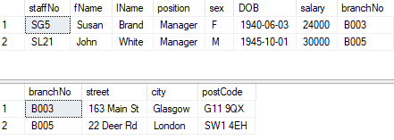
Stored Procedure With Multiple statements
CREATE PROCEDURE SelectPositionWiseStaff_branch @position varchar(30)
AS
SELECT * FROM staff WHERE position = @position;
SELECT * FROM branch where branchno in (select branchno from staff where position= @position);
execute SelectPositionWiseStaff_branch ‘manager’;

Slide 11
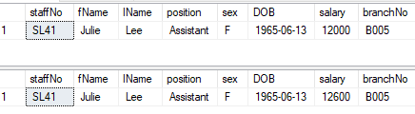
Salary updation of an Assistant SL41
CREATE PROCEDURE salaryUpdationStaff @position varchar(30), @staffno varchar(30), @salary int
AS
SELECT * FROM staff WHERE position = @position AND staffno=@staffno;
update staff set salary = salary+(salary *@salary/100) where position = @position AND
staffno=@staffno;
SELECT * FROM staff WHERE position = @position AND staffno=@staffno;
execute salaryUpdationStaff 'Assistant’, 'SL41’, 5;

Slide 12
Summary
SQL Stored Procedure

